Slide 1
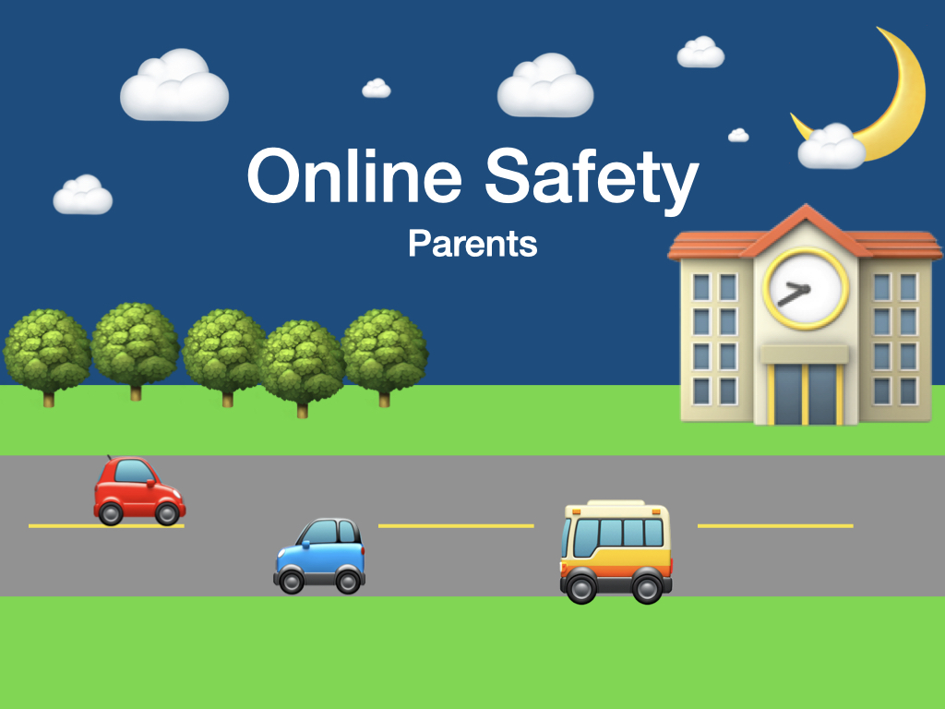

Slide 4
Children have access to an incredible world online.
We want children to understand that any app or game that allows them to connect with others can be a threat.
Through online safety teaching, we ensure that children behave is a safe, responsible way when accessing any app or game.

Slide 5
Set parental controls early
Discuss the use of child-friendly apps – eg. Youtube Kids rather than TikTok
https://www.ofcom.org.uk/__data/assets/pdf_file/0024/234609/childrens-media-use-and-attitudes-report-2022.pdf

Slide 7
What games are they playing?
Focus is on the game. Communication is freely accessible in most games – Who are they talking to?
Streaming – How do we know what the children are watching? How do we keep on top of what they are sharing?
https://www.ofcom.org.uk/__data/assets/pdf_file/0024/234609/childrens-media-use-and-attitudes-report-2022.pdf

Slide 8
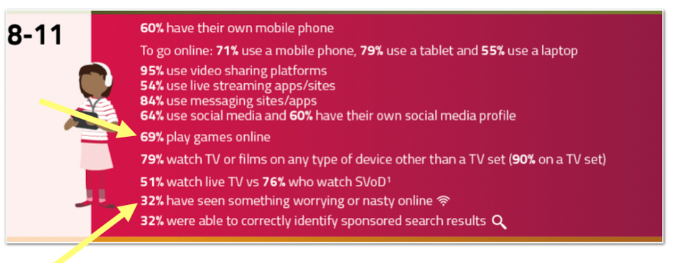
Gaming
Inappropriate content – When was the last time your child told you they have seen something worrying or nasty online?
https://www.ofcom.org.uk/__data/assets/pdf_file/0024/234609/childrens-media-use-and-attitudes-report-2022.pdf

Slide 10
Talk about the benefits
Ask why they like their favourite app or game.

Slide 11
Discuss their online experiences.
Consider the pressure that children might feel to keep up with trends.

Slide 12
Make it ok for children to make mistakes online.
They will not be punished and we can talk about it.

Slide 15
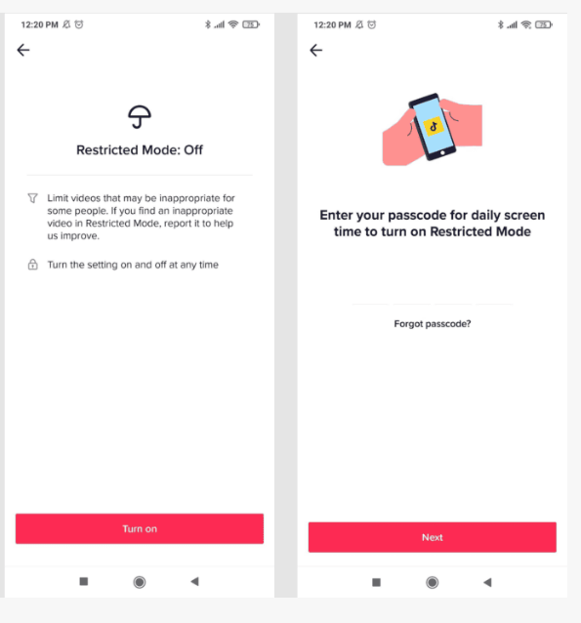
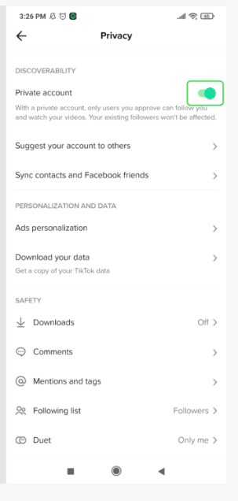
Most apps and games that your children access come with parental controls and restrictions.

Slide 16
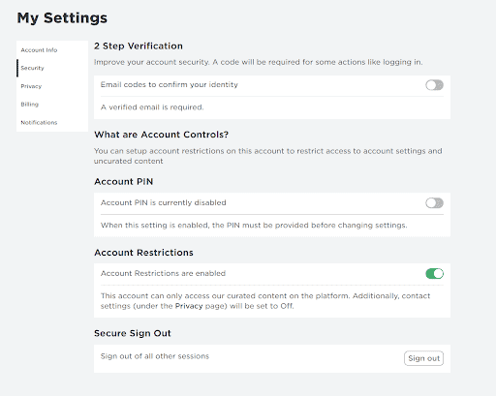
Most apps and games that your children access come with parental controls and restrictions.

Slide 17
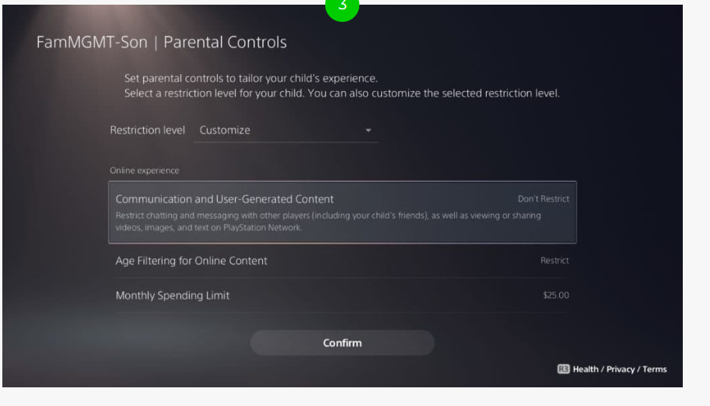
Most apps and games that your children access come with parental controls and restrictions.

Slide 19
This is free from your Wifi provider

Slide 21
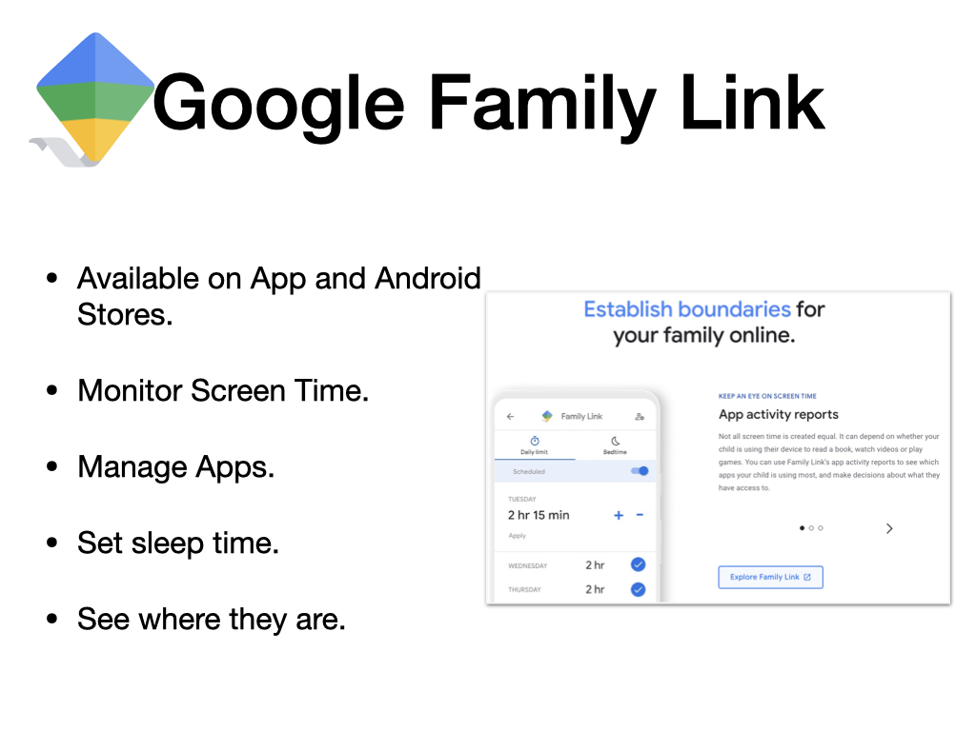

Slide 23
Support for you
You can always speak to:
NSPCC
School
Or for more general information you can visit these sites:
UK Safer Internet Centre (https://www.saferinternet.org.uk/)
Internet Matters (https://www.internetmatters.org/)
The Parent Zone (https://parentzone.org.uk/home)

